Slide 1
Final Presentation - Capstone project
Find a Better Neighborhood in Scarborough, Tornoto
Author - Sohan Kumar

Slide 2
Introduction
Project is suppose to help people in exploring better facilities around their neighborhood. It will help them take smart and efficient decisions on selecting great neighborhood in Scarborough, Toranto.
This Project aims to perform analysis of facilities for people migrating to Scarborough in search of a better neighborhood as a comparative analysis between neighborhoods. The facilities are median house pricing, better schools, crime rate, road connectivity, weather conditions, emergency help, water resources both fresh and waste water facilities.
Following are expected out of this project deliverable:
1. Sorted list of houses in terms of pricing
2. Sorted list of schools in terms of location, fees, rating and reviews

Slide 3
Data used for Project
Data Link: https://en.wikipedia.org/wiki/List_of_postal_codes_of_Canada:_M
Have used Scarborough dataset which we scrapped from wikipedia on Week 3. Dataset consisting of latitude and longitude, zip codes.
Foursquare API Data:
Foursquare is a location data provider with information about all manner of venues and events within an area of interest. Such information includes venue names, locations, menus and even photos. As such, the foursquare location platform will be used as the sole data source since all the stated required information can be obtained through the API.
After finding the list of neighborhoods, we then connect to the Foursquare API to gather information about venues inside each neighborhood. For each neighborhood, we have chosen the radius to be 100 meter.

Slide 4

Data for project Contd..
The data retrieved from Foursquare contained information of venues within a specified distance of the longitude and latitude of the postcodes. The information obtained per venue will be as follows:
1. Neighborhood
2. Neighborhood Latitude
3. Neighborhood Longitude
4. Venue
5. Name of the venue
6. Venue Latitude
7. Venue Longitude
8. Venue Category

Slide 5
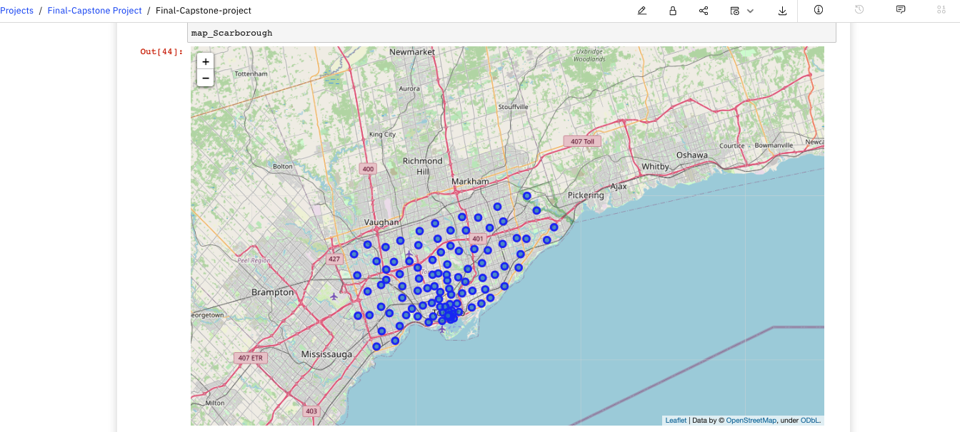
Scarborough Map

Slide 6
Methodology
Clustering Approach
To compare two cities, we decided to explore neighborhoods, segment them, and group them into clusters to find similar neighborhoods in a big city like Toronto. To do that, we needed to cluster data that is a form of unsupervised machine learning: k-means clustering algorithm.
k-means clustering
To compare two cities, we decided to explore neighborhoods, segment them, and group them into clusters to find similar neighborhoods in a big city like Toronto. To do that, we needed to cluster data that is a form of unsupervised machine learning: k-means clustering algorithm.

Slide 7
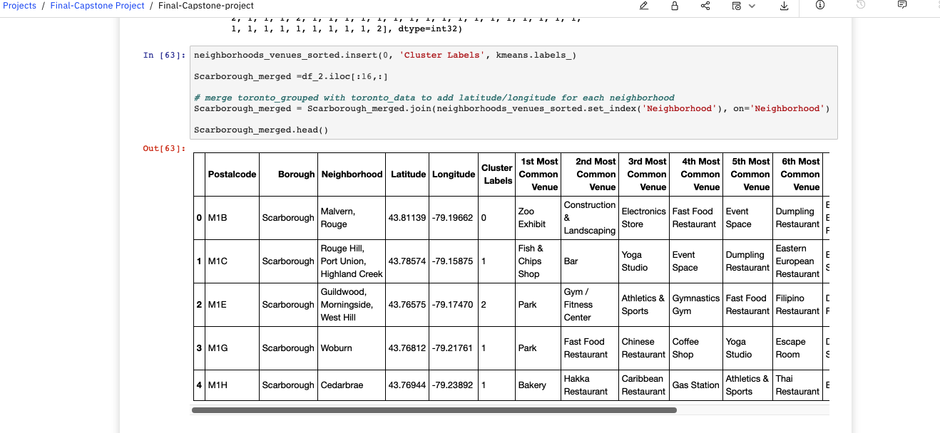
k-means clusteting contd..

Slide 8
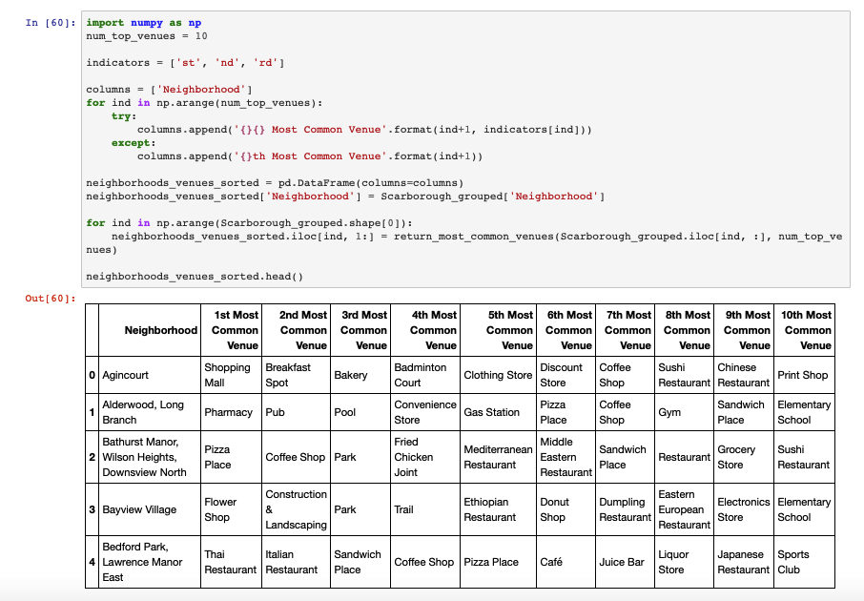
Most common values near neighborhood

Slide 9
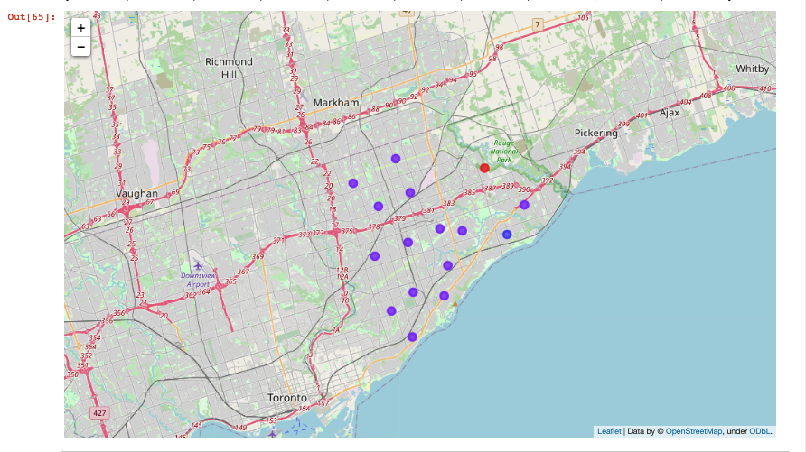
Results
Map of clusters in Scarborough

Slide 10
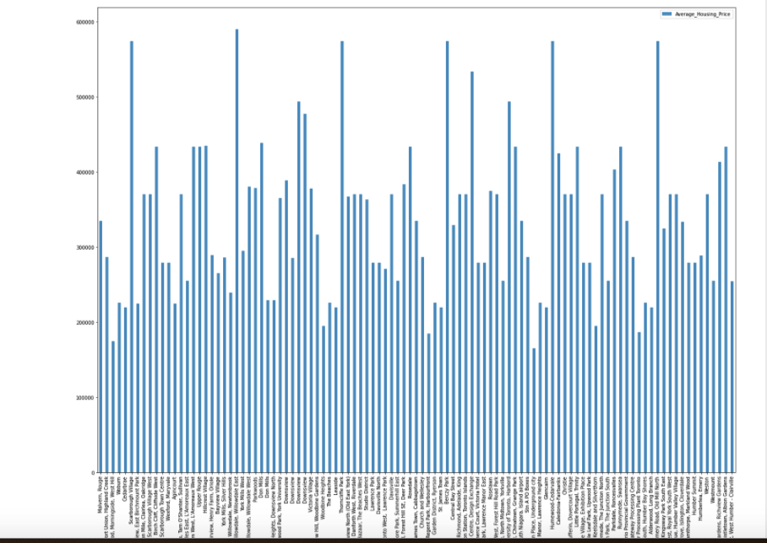
Results
Average Housing price by cluster in Scarborough

Slide 11
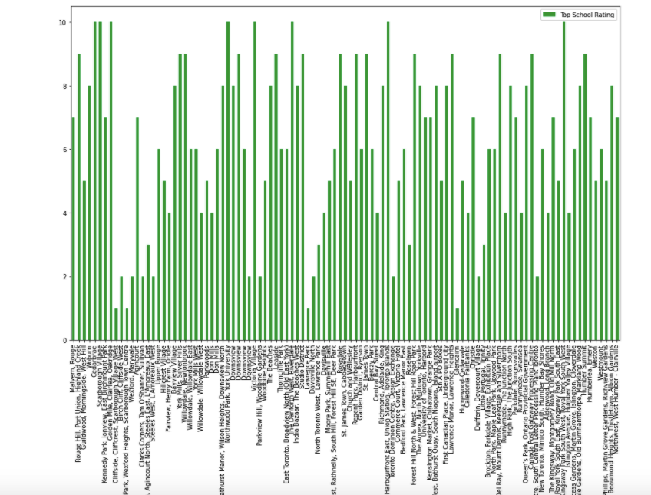
Results
Scarborough school ratings by cluster

Slide 12
Discussion
Project is suppose to help people in exploring better facilities around their neighborhood. It will help them take smart and efficient decisions on selecting great neighborhood in Scarborough, Toranto.
This Project aims to perform analysis of facilities for people migrating to Scarborough in search of a better neighborhood as a comparative analysis between neighborhoods. The facilities are median house pricing, better schools, crime rate, road connectivity, weather conditions, emergency help, water resources both fresh and waste water facilities.
Following are expected out of this project deliverable:
1. Sorted list of houses in terms of pricing
2. Sorted list of schools in terms of location, fees, rating and reviews

Slide 13
Conclusion & Future Work
In this project, using k-means cluster algorithm I separated the neighborhood into 10(Ten) different clusters and for 103 different lattitude and longitude from dataset, having very-similar neighborhoods around them. Using the charts above results presented to a particular neighborhood based on average house prices and school ratings.
This project can be continued to make it better for precise results.

Slide 14
Libraries used to Develop the Project
01
Pandas: For creating and manipulating dataframes.
02
Folium: Python visualization library
03
Scikit Learn: For importing k-means clustering.
04
JSON: Library to handle JSON files.
05
XML: To separate data from presentation and XML stores data in plain text.
05
Geocoder: To retrieve Location Data
05
Beautiful Soup and Requests: To scrap and library to handle http requests.
05
Matplotlib: Python Plotting Module.

Slide 15
Thank You!
Happy Learning!

